Slide 1
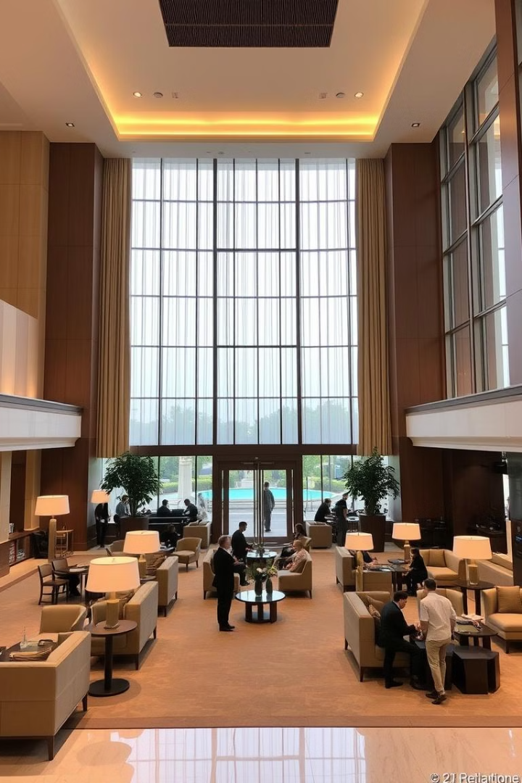
Hotel Booking System: A Modern Approach
This presentation outlines a comprehensive hotel booking system designed to enhance guest experiences and streamline operations.

Slide 2
Introduction: The Need for Efficient Hotel Reservations
Growing Demand
Competition
The hospitality industry faces a growing demand for hotel reservations, driven by increased travel and tourism.
Competition among hotels is fierce, making it essential to offer a seamless and efficient booking experience.

Slide 3
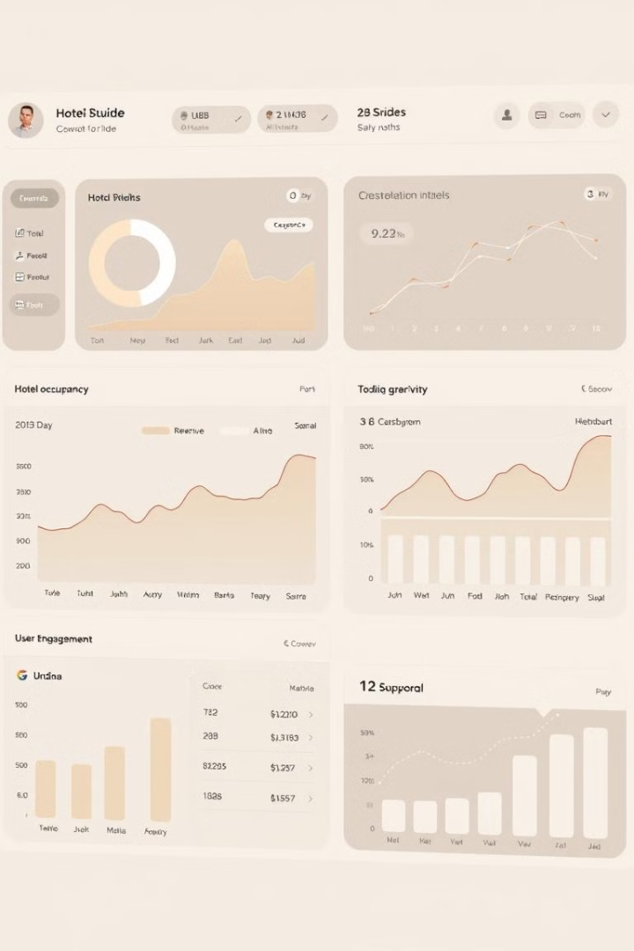
Key Features of Our Hotel Booking System
1
User-Friendly Interface
2
Real-Time Availability
Guests can view real-time room availability and pricing, eliminating frustration and wasted time.
Our system provides a user-friendly interface, ensuring easy navigation and a positive experience.
3
Secure Payments
4
Mobile Optimization
Secure payment processing protects sensitive financial data and guarantees secure transactions.
Our system is fully optimized for mobile devices, allowing guests to book from anywhere, anytime.

Slide 4
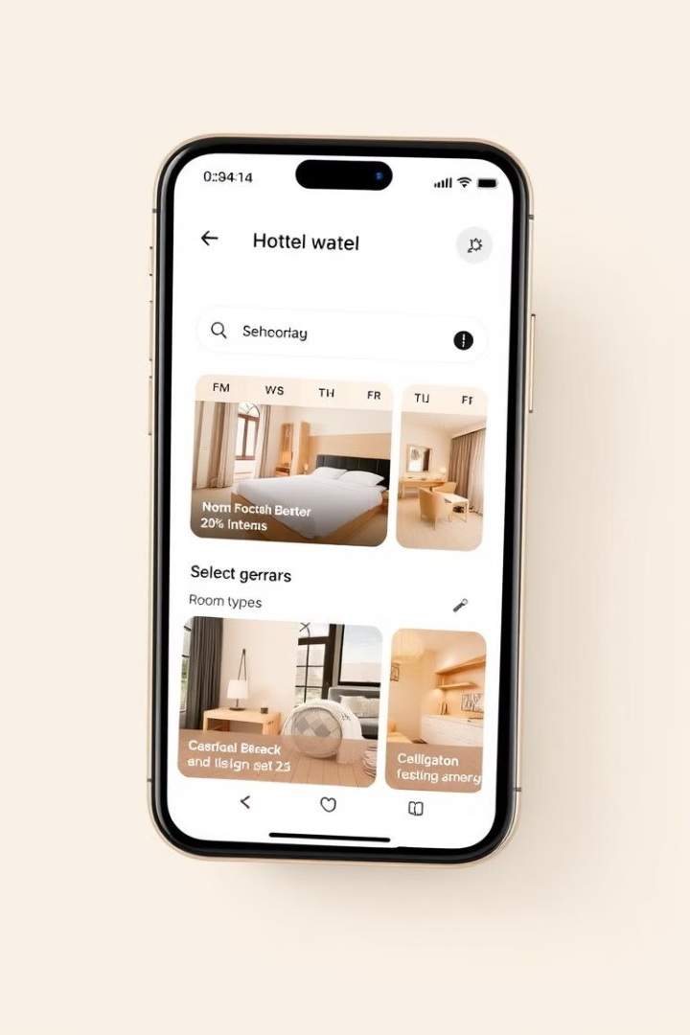



Seamless User Interface and Navigation
Search Filters
Calendar Date Selection
Intuitive filters allow guests to easily find the perfect hotel based on their preferences.
A user-friendly calendar interface makes it easy to select desired arrival and departure dates.
Hotel Information
Detailed hotel information, including photos, amenities, and guest reviews, helps guests make informed decisions.

Slide 5

Real-Time Availability and Pricing Updates
1
2
3
Dynamic Pricing
Inventory Management
Price Comparisons
Real-time pricing updates ensure guests always see the most accurate rates, taking into account demand and availability.
The system automatically updates room inventory based on bookings, preventing overbooking and ensuring accurate availability.
Guests can compare prices across different room types and dates to find the best value for their stay.

Slide 6

Secure Payment Processing and Reservation Confirmation
Secure Payment Gateways
Reservation Confirmation
The system integrates with trusted payment gateways to ensure the security of financial transactions.
Guests receive instant confirmation of their bookings, including a detailed itinerary and booking reference number.
Payment Options
The system supports a variety of payment options, including credit cards, debit cards, and online payment methods.

Slide 7



Advanced Reporting and Analytics
Performance Tracking
1
Track key metrics like booking volume, revenue, and occupancy rates to identify trends and areas for improvement.
Guest Insights
2
Gain valuable insights into guest demographics, booking patterns, and preferences to personalize experiences.
Operational Efficiency
3
Optimize operations based on data-driven insights to maximize revenue, streamline processes, and enhance guest satisfaction.

Slide 8
Integrations with Third-Party Platforms
Channel Management
1
Integrate with popular travel agencies and online travel agents (OTAs) to expand reach and maximize bookings.
Guest Relationship Management (CRM)
2
Integrate with CRM systems to manage customer interactions, personalize communications, and enhance guest loyalty.
Property Management System (PMS)
3
Seamless integration with PMS systems ensures real-time updates on availability, bookings, and guest information.

Slide 9

Conclusion: Transforming Hotel Booking Experiences
By implementing a modern and efficient hotel booking system, hotels can transform guest experiences, streamline operations, and achieve greater success in the competitive hospitality market.

